Slide 3
ASIASWEEP 2023 The Arun Veembur Memorial Quiz
Shout out to
QFI Chennai, K-Circle Hyderabad, Bombay Quiz Club, SEQC-Goa, Bengal Quiz Foundation, Delhi Quiz Club, BCQC Pune,
and to quizzing communities in Ahmedabad, Coimbatore, Guwahati,
Kozhikode, Manipal, Raiganj, Thrissur, Udaipur, and Boston!
ASIASWEEP 2023

Slide 4
ASIASWEEP 2023 The Arun Veembur Memorial Quiz
Edition IX
Researched by
Nagaratna ‘Partikal’ Patil
Urmila Lakshmanan
Dibyendu Das
Arul Mani
ASIASWEEP 2023

Slide 5
ASIASWEEP 2023
SECTION I
RULES
20 questions
Stake +1 on a maximum of 10
No negatives Max. score: 30
ASIASWEEP 2023

Slide 6
Qn 1.
The first lady, Kim Keon Hee, has repeatedly voiced her support for this ban. But farmers are calling for a longer grace period and direct financial compensation. They also say their businesses will naturally disappear when older people, their main customers, die.
The plan is to phase X out completely by 2027. What are we talking about ?
ASIASWEEP 2023

Slide 7
Qn 2.
When Omar Sultan al Olama assumed this office in UAE in 2017, it was the first instance in the world that such a ministry has been created by the ruling Government. His primary role involves creating and fostering international efforts in responsibly governing certain technology and reflecting the UAE's vision on its ethical use.
What is this new ministry ?
ASIASWEEP 2023

Slide 8
Qn 3.
In the women's 100-meter hurdles final at the Hangzhou Asian Games 2023, Chinese athletes Lin Yuwei and Wu Yanni found themselves in a poignant embrace. However, the image faced a bizarre censorship on the Chinese social media. Why ?
ASIASWEEP 2023

Slide 9
Qn 3.
ASIASWEEP 2023

Slide 10
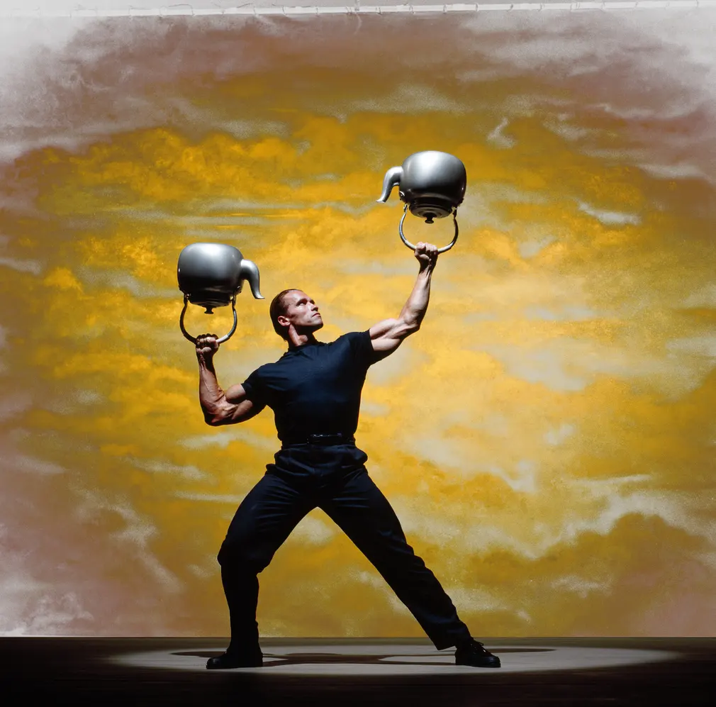
Qn 4.
Arnie, featuring in what famous ready-to-eat item’s advertisement in 1989 ? Your answer must have company and brand
ASIASWEEP 2023

Slide 11
Qn 4.
ASIASWEEP 2023

Slide 12
Qn 5.
Inspired by true events, this 2023 OTT series depicts the trials and tribulations of two women, Munira and Farida, who try to break into a profession dominated by men in 1980s Kuwait.
Either name the series (8 letters) or the location/context of their work. (Pic next slide).
ASIASWEEP 2023

Slide 13
Qn 5.
ASIASWEEP 2023

Slide 14
Qn 6.
For the album Thriller, Michael Jackson decided to record a cover version of Yellow Magic Orchestra’s ‘Behind the Mask.’ - from their album ‘Solid State Survivor’. However, the song didn’t finally make the cut due to royalty and other issues though it did appear in 2011 in the album ‘Michael’ published posthumously.
Name the band’s lead musician who also went on to star in Nagisa Oshima’s Merry Christmas Mr. Lawrence opposite David Bowie.
ASIASWEEP 2023

Slide 15
Qn 6.
ASIASWEEP 2023

Slide 16
Qn 7.
It is referred to as 'Sri Pada' in Sinhalese because the footprint-shaped mark at the summit is believed to be that of the Buddha.
What is the more common name of the 7,359 ft tall mountain in Sri Lanka, alluding to a castaway from paradise?
ASIASWEEP 2023

Slide 17
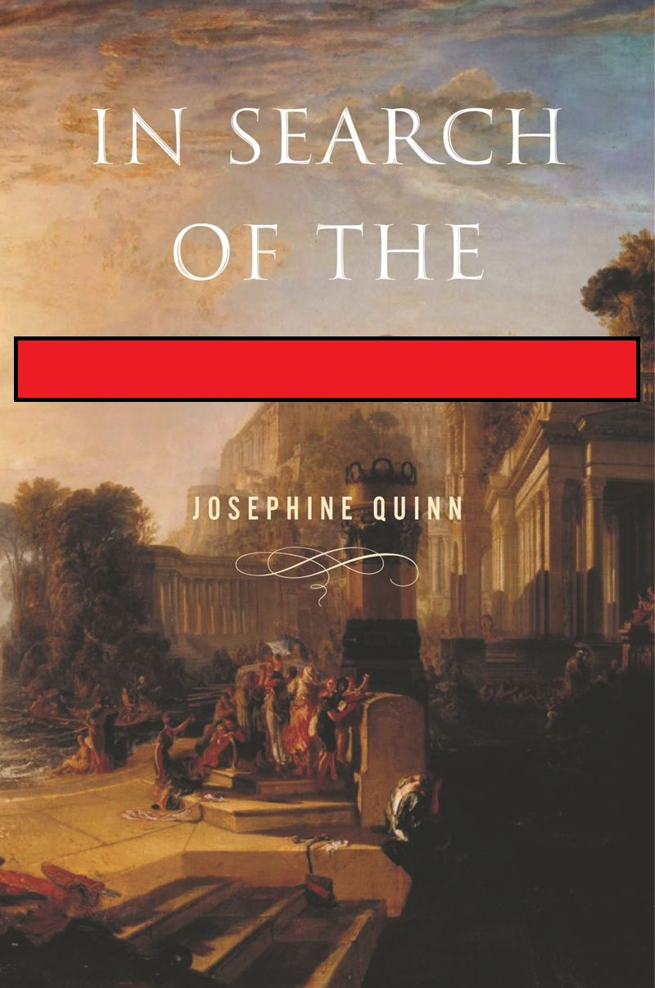
Qn 8.
Herodotus seems to have coined the term X - from the ancient Greek word for palm tree (and not a bird)- to denote sailors who originated in the Red Sea area and settled in the Mediterranean area.
Josephine Quinn’s book claims that the Xs never actually existed- the notion of these sailors as a people with a shared identity, history, and culture is a product of modern nationalist ideologies- very much at odds with the ancient sources. X?
ASIASWEEP 2023

Slide 18
Qn 9.
In 1876 the summer capital of the colonial Punjab Government moved from Murree (now in Pakistan) to Shimla. When a brewery was set up in Murree in 1860, X was appointed as its first general manager, because of his experience in a place near Shimla? His son would go on to make the surname famous some 59 years later. Just give the surname.
ASIASWEEP 2023

Slide 19
Qn 10.
Name the group that was the first Asian act to headline Coachella and also was Time magazine's 2022 Entertainer of the Year—or work it out from the picture.
ASIASWEEP 2023

Slide 20
Qn 10.
ASIASWEEP 2023

Slide 21
Qn 11.
This Bangladeshi city gets its name from an officer of the East India Company, who was sent on a diplomatic mission to Burma, and later helped resettle refugees till his death in 1799.
Which city, with a beach that is often termed the "longest natural unbroken sea beach" in the world (155 km long).
ASIASWEEP 2023

Slide 22
Qn 12.
In the very racist 1920s, Chinese American college graduates could not get jobs outside of curio shops and restaurants and laundries. Around the same time a pastime was sweeping the US, and Chinese Americans found a lucrative opportunity as 'authentic teachers', even though they learned it from the same instruction manuals.
What pastime, popularised in the US by JP Babcock, who even trademarked a spelling?
ASIASWEEP 2023

Slide 23
Qn 13.
From 2001 these luxury consumables from Japan have steadily been capturing the international market.The domestic demand for this product saw an upward spike thanks to the 2014 soap opera 'Massan' based on the story of Masataka Taketsuru, and his Scottish wife Rita —a rare cross-cultural relationship in the 1920s.
What product? (Give a generic answer).
ASIASWEEP 2023

Slide 24
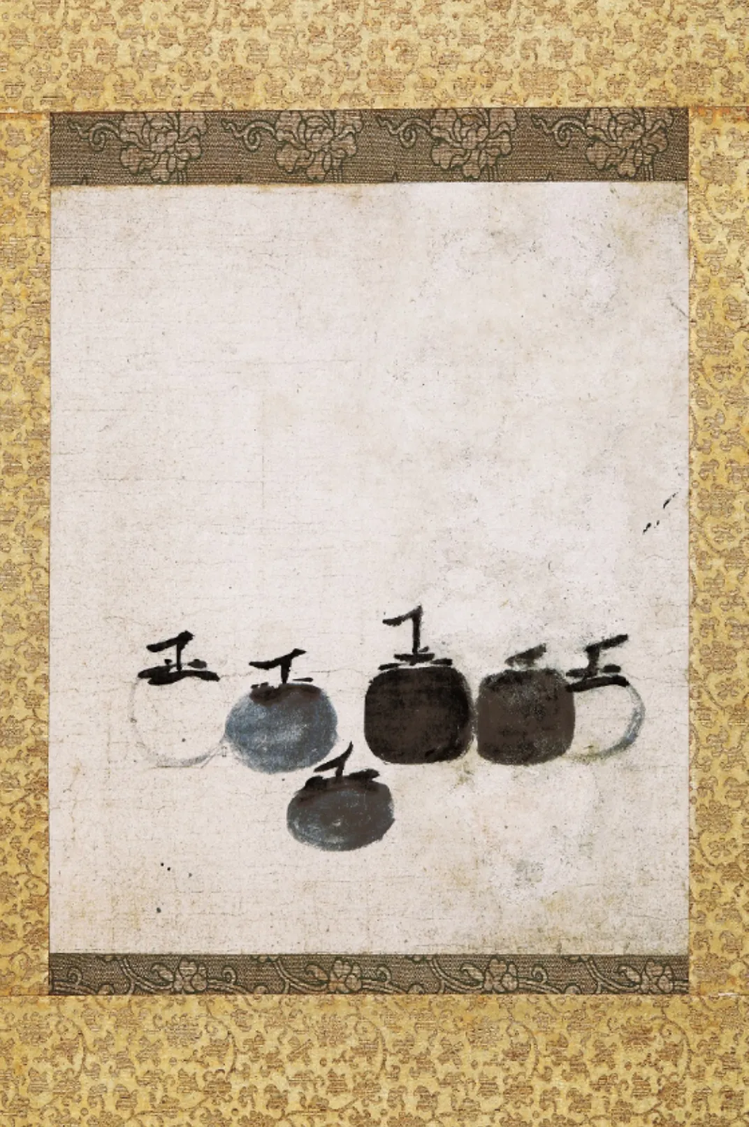
Qn 14.
‘Six ----------' painted by Muqi Fachang during the late Song dynasty is considered the “Zen Mona Lisa". By depicting a fruit that was devoid of connotations in Chinese culture, the artist is supposedly forcing the viewer to appreciate the subject for what it is and not for what it could mean. Japan has owned the painting for about 500 years and the fruit is of significance there.
FITB with the name of the fruit. (9 letters)
ASIASWEEP 2023

Slide 25
Qn 14.
ASIASWEEP 2023

Slide 26
Qn 15.
Kim Da-in was frustrated because she turned 6 and then became 5 again, but Choi Eun-young wecomed it because she no longer feels the need to describe herself as being in her 50s.
What took place on 28th June, 2023 that made them feel this way?
ASIASWEEP 2023

Slide 27
Qn 16.
This installation at the Tate Modern is designed by Brazilian conceptual artist Cildo Meireles. It consists of a stack of radios tuned to different stations, all playing.
From what does it take inspiration?
ASIASWEEP 2023

Slide 28
Qn 17.
Sopheap Pich is a Cambodian American contemporary artist. His sculptures utilize traditional Cambodian materials like rattan and are informed by his childhood experiences under the Khmer Rouge regime.
His 2011 work, ________ _____ depicts a plant that was integral to the people’s survival during that period.
Name the art work. Two-word phrase (7,5).
ASIASWEEP 2023

Slide 29
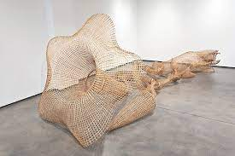
Qn 17.
ASIASWEEP 2023

Slide 30
Qn 18.
The "Hymn to Liberty", or "Hymn to Freedom" is a poem written by Dionysios Solomos in 1823 that consists of 158 stanzas. It is used as the national anthem by both Greece and a country that is classified as Asian geographically but is nevertheless a member of the European Union..
Which country?
ASIASWEEP 2023

Slide 31
Qn 19.
Chaharshanbeh Suri is an Iranian festival of the fire dance celebrated around the middle of the last week of the year and is the first festivity of Nowruz.
The word suri has two meanings - “festive” and “scarlet” - and both seem to fit given the theme.
Chaharshanbeh only has one meaning. What?
ASIASWEEP 2023

Slide 32
Qn 20.
On the 7th of July 2008, George Town, Penang was awarded World Heritage Site status by UNESCO. The state government decided to commemorate the occasion with a project called “Marking George Town”. The concept was to tell the people of George Town´s stories and portrait the everyday life of George Town through a series of cartoon steel art pieces all across the city. One of the art pieces was created to honour a famous designer who was born in George Town and completed an apprenticeship at the nearby Hong Kong Store.
Name the designer.
ASIASWEEP 2023

Slide 33
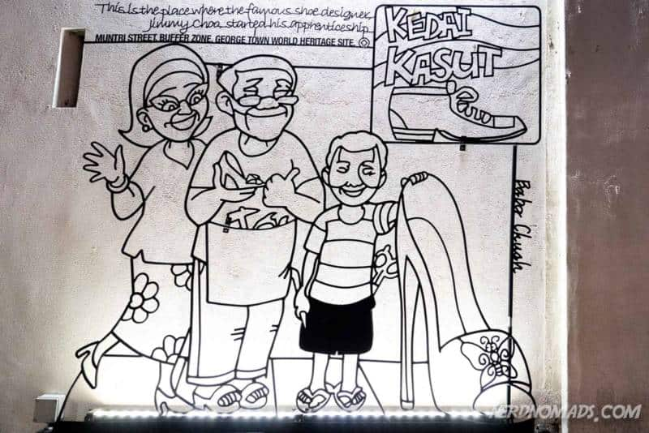
Qn 20.
ASIASWEEP 2023

Slide 34
ASIASWEEP 2023
SECTION II
RULES
15 questions
Two-pointers
Each part is worth one point
Please follow the suggested order for parts A and B
ASIASWEEP 2023

Slide 35
Qn 21
In the desert north of Al Ula in Saudi Arabia, beautifully carved classical-style pediments and columns, stand in the sands. Once a thriving international trade hub, the archeological site Hegra has been opened to tourists in 2020.
The rock-cut constructions look similar to its more famous sister site A, a few hundred miles to the north belonging to the same Nabataean kingdom.
Hegra is also known as Mada’in Salih, and this is thought to refer to a character B, also found in the Bible. Give the sister site A and the character B.
ASIASWEEP 2023

Slide 36
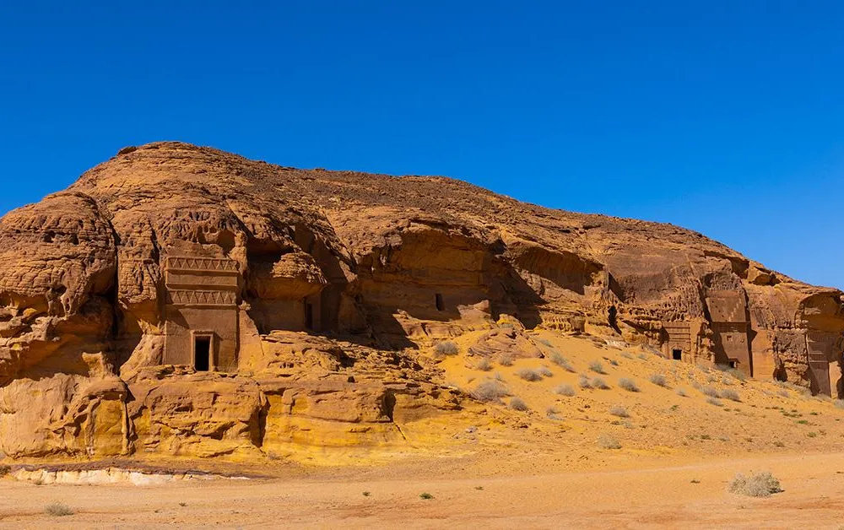
Qn 21.
ASIASWEEP 2023

Slide 37
Qn 22.
One of the reasons offered for the event in the book A begins with the sentencing of Zainab, a blind woman to death by stoning for being the victim of a gang rape. For being punished thus, Zainab puts a curse upon B. The curse is picked up by a sugar-obsessed crow who crashed into the engine of a vehicle carrying some luscious fruit, thus affecting B.
Identify the book A and the person B.
ASIASWEEP 2023

Slide 38
Qn 23.
A is a popular music and arts festival started in 2008 in the city B by Jay Forster, Mike Hill and Justin Sweeting. When asked about the origin of the name Forster said: “I was ordering a lot of techno records from Berlin and DJ'ing, and these records had really strange names like 'plippenflappen', and 'schlappenclippen', and 'knoppentoppen', and all this kind of stuff,”.
Name the festival A and the host city B.
ASIASWEEP 2023

Slide 39
Qn 23.
ASIASWEEP 2023

Slide 40
Qn 23.
ASIASWEEP 2023

Slide 41
Qn 24.
He made his debut in 1966 with Diamond 33, a James-Bond knockoff in which a professor who found a way to make diamonds from oil is killed in the capital and his spy nephew is sent by Interpol to find it. In 1969 he directed his first masterpiece B which kickstarted a so-called New Wave in that country.
Last year he criticised censorship in his country and dared the authorities to kill him for resisting. He and his wife were found dead with stab wounds in October.
Name this pioneer A and the 1969 film B.
ASIASWEEP 2023

Slide 42
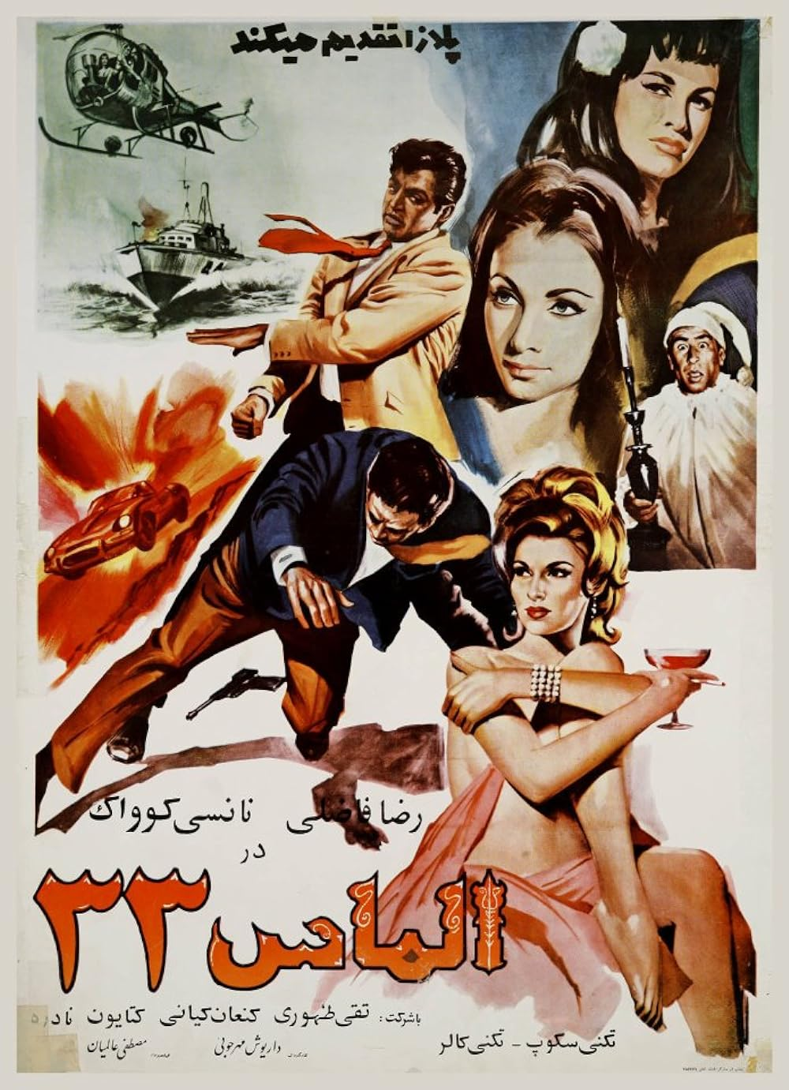
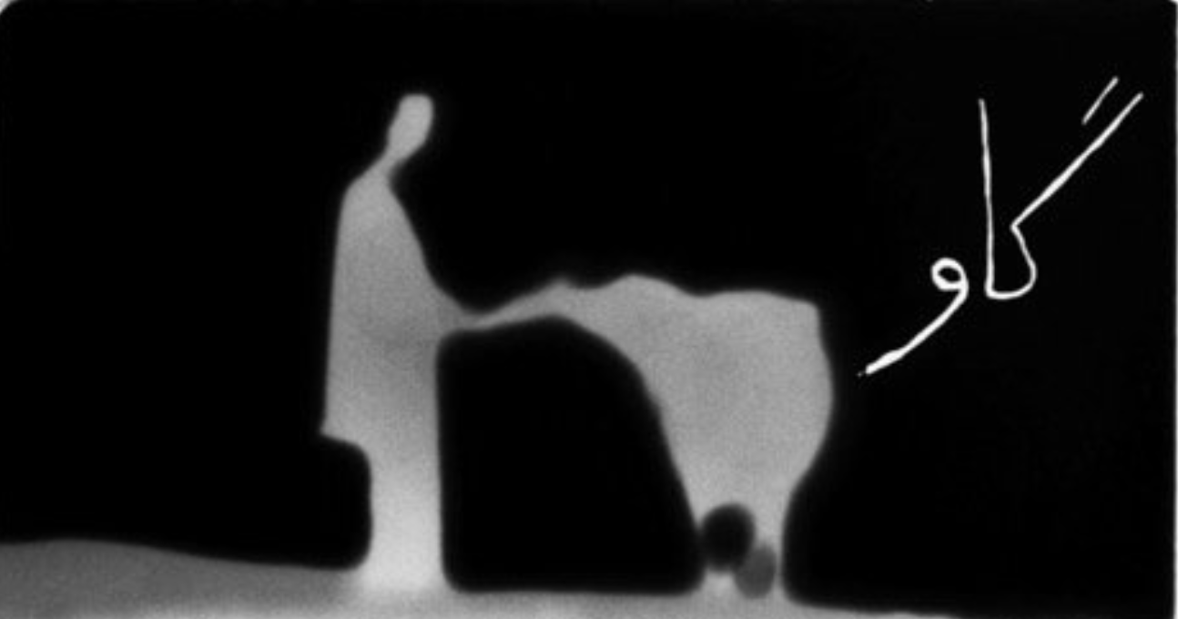
Qn 24.
ASIASWEEP 2023

Slide 43
Qn 25.
What are the two seas fed by the Jordan river, each of them topping a worldwide list?
ASIASWEEP 2023

Slide 44
Qn 26.
In this 2008 train travel book, the author retraces some of the trips described in his earlier book of 1975, which is regarded as a classic of travel writing, even though it has ethnic generalisations and some fiction.
Name the 1975 book and author.
ASIASWEEP 2023

Slide 45
Qn 27.
"Why had China been overtaken by the West in science and technology, despite their earlier successes?" This is known as "The ------- question". FITB with the surname of A, a British biochemist, historian of science and sinologist.
A once went on a visit to the caves of Dunhuang simply because B, so named on account of its power to dispel illusion, was discovered there in the early 1900s. What is B, reputed to cut through illusion like a lightning-bolt?
ASIASWEEP 2023

Slide 46
Qn 28.
Besides silk, this book describes two other yarns that tangled their way through Central Asia- A, that created the clothing and housing needed by the nomadic cultures that were to dominate Middle Asia; and B, that was one of the reasons for Imperial Russia colonising Turkestan. A and B? In that order, please.
ASIASWEEP 2023

Slide 47
Qn 29.
This vast area A, sometimes known as The Polygon, saw concerted activity between 1949 and 1989. It takes its name from an ancient Buddhist monastery with seven chambers.
The wordless 2014 film Test refers to the inaugural 1949 moment, also known as Joe One and First Lightning in different parts of the world. The man in charge of this moment B is famous for having been Rutherford’s competition for a certain distinction. Name A and B
ASIASWEEP 2023

Slide 48
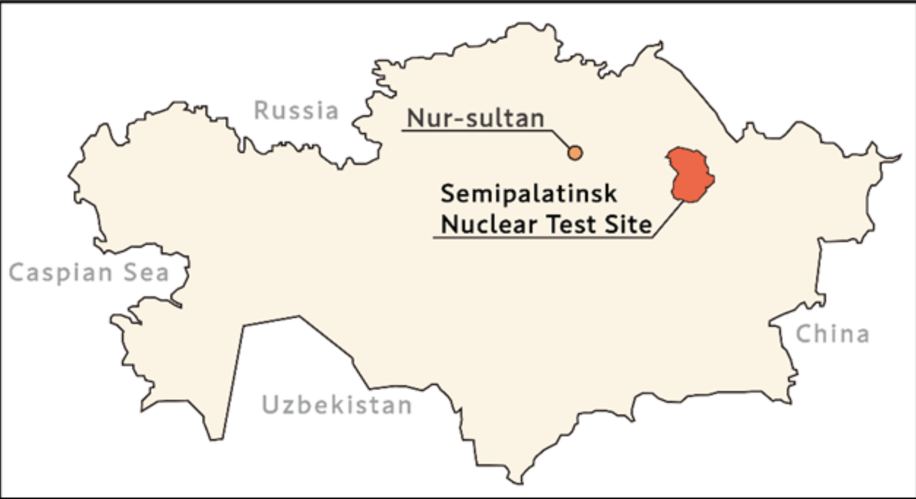
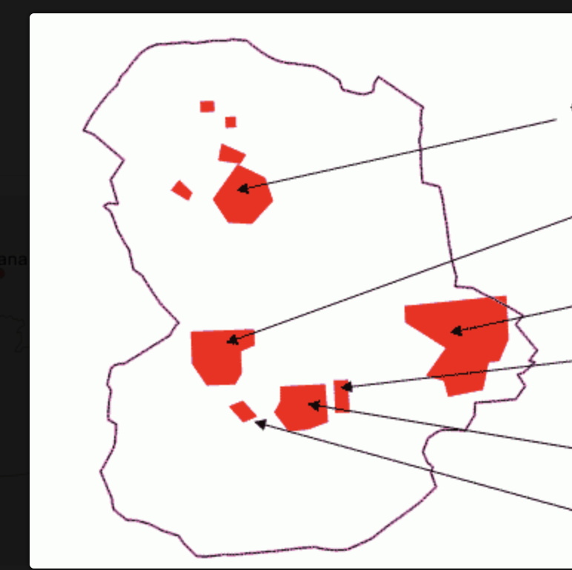
Qn 29.
ASIASWEEP 2023

Slide 49
Qn 30.
Apart from being an artist, she was an art historian, a professor, the principal of one college and the dean of another. She was the co-host of a children’s show called “Akkar Bakkar” and a caretaker minister. One of her more famous works is a series of paintings titled The People Wept At Dawn (one of them is shown on the next slide) that she made in the late 90s.
Identify her or her famous parent.
What were the paintings in response to?
ASIASWEEP 2023

Slide 50
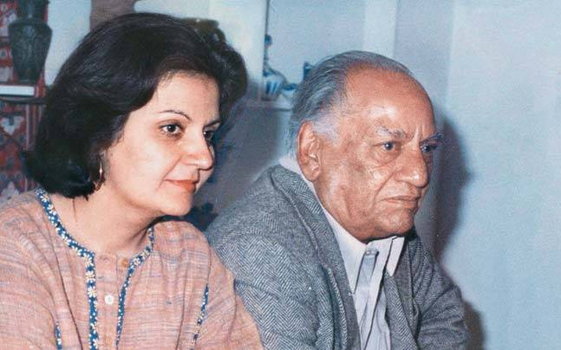
Qn 30.
With parent
ASIASWEEP 2023

Slide 51
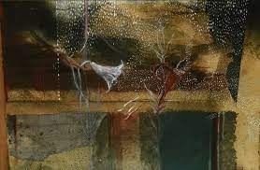
Qn 30.
ASIASWEEP 2023

Slide 52
Qn 31.
The Proximity Housing Grant is a government handout in country X designed to solve a major social problem noticed in the West.
Which country? What problem are they trying to solve?
ASIASWEEP 2023

Slide 53
Qn 32.
The traumatic events A known for short as 3-11 continue to cast a long shadow over B’s creative efforts to this day. His most recent effort B1 uses this inanimate object, where a missing leg refers back to A and its disruptive consequences.
What is A/3-11?
Either name the person B or the creative effort B1.
ASIASWEEP 2023

Slide 54
Qn 32.
ASIASWEEP 2023

Slide 55
Qn 33.
These artworks from a neighbouring capital B are produced for a specific purpose A. The art is now inscribed in the UNESCO Intangible Human Heritage register.
What purpose/use is this art produced for?
Name the city B.
ASIASWEEP 2023

Slide 56
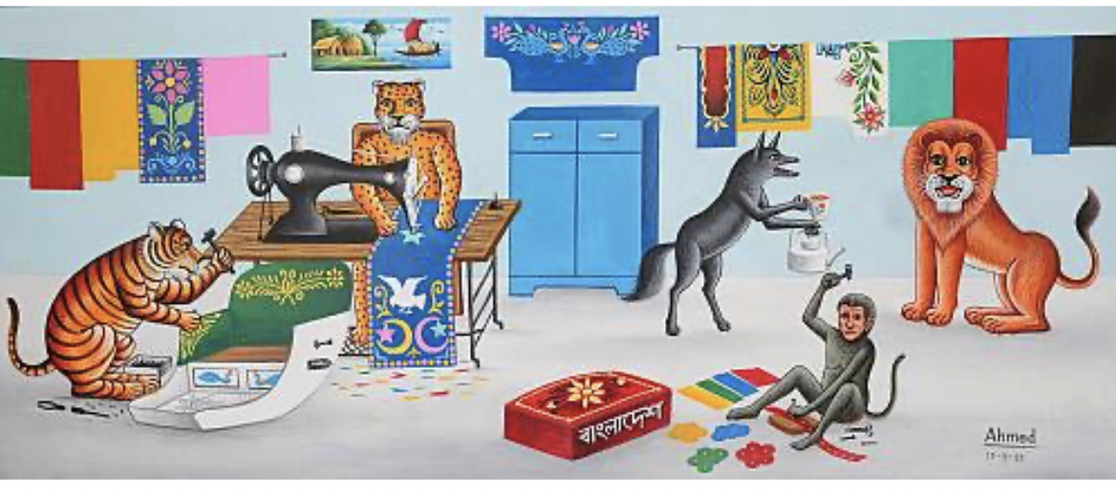
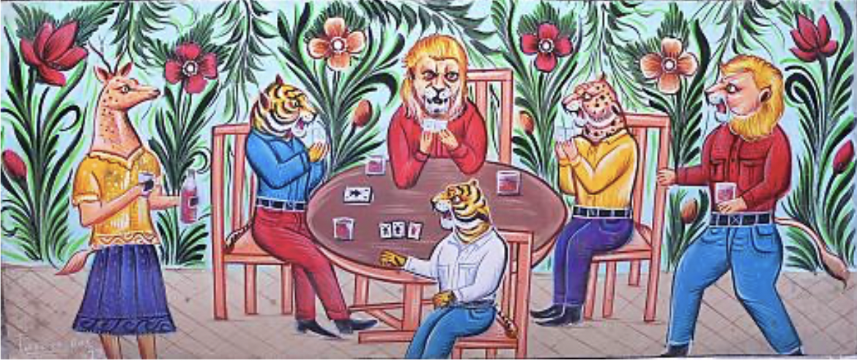
Qn 32.
ASIASWEEP 2023

Slide 57
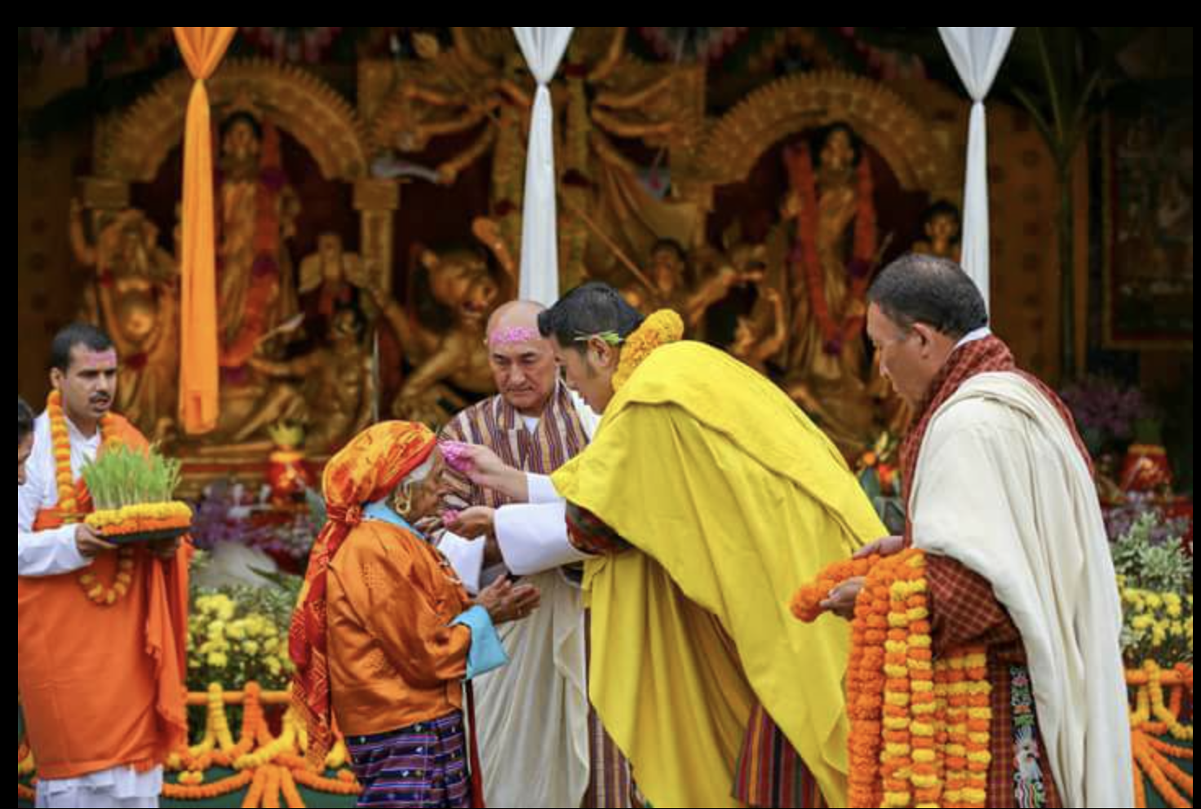
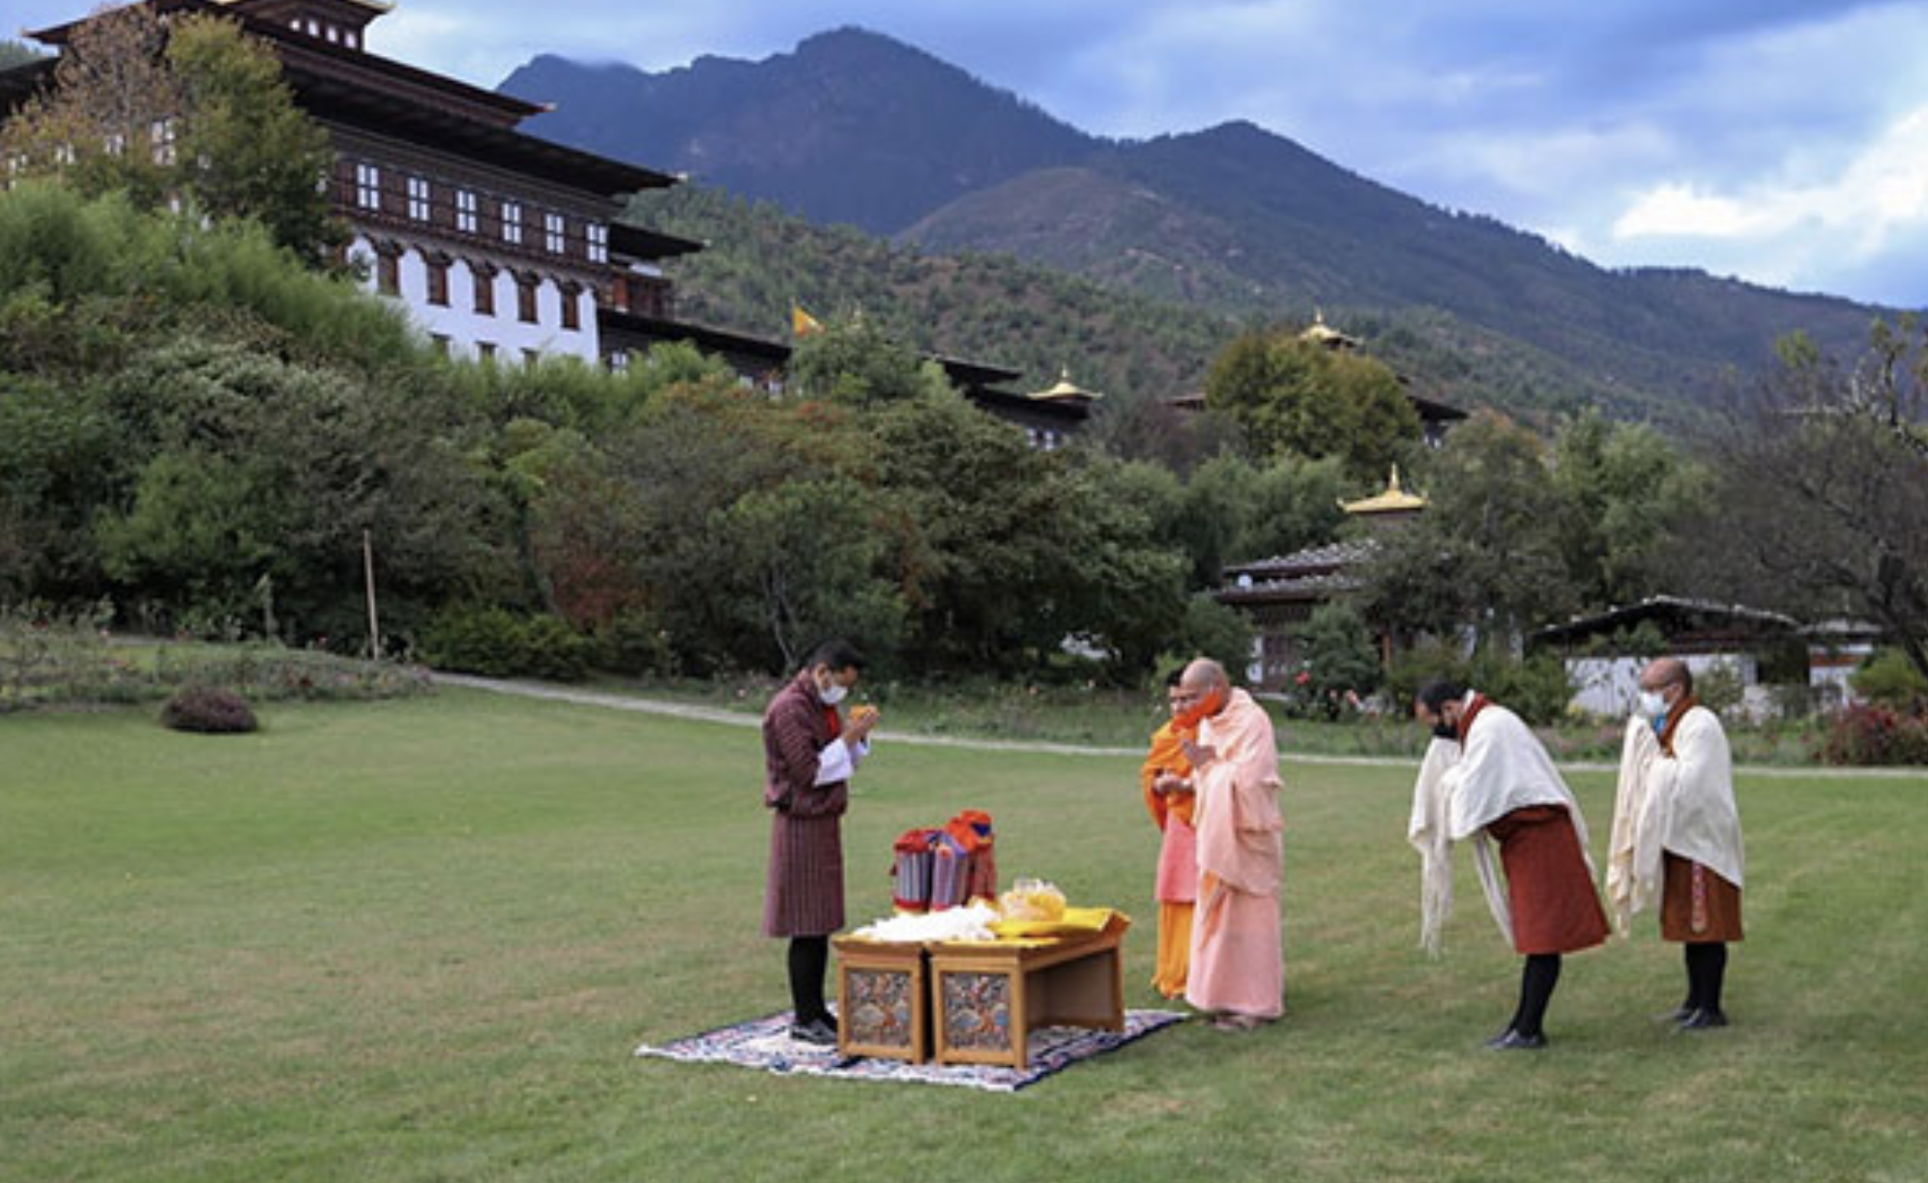
Qn 34.
This ceremonial moment traditionally begins festivities and is also a way of reaching out to a minority. A. What is happening here? B. What festival?
ASIASWEEP 2023

Slide 58
Qn 34.
ASIASWEEP 2023

Slide 59
Qn 34.
ASIASWEEP 2023

Slide 60
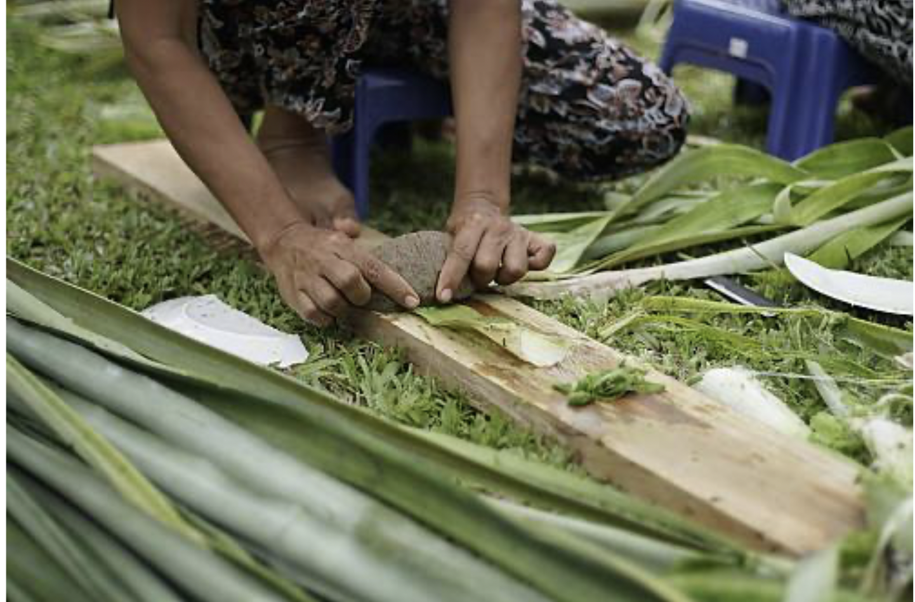
Qn 35.
Method by which yarn and fabric are generated. Name A. the source and B. the country.
ASIASWEEP 2023

Slide 61
Qn 35.
ASIASWEEP 2023

Slide 62
Qn 35.
Method by which yarn and fabric are generated. Name A. the source and B. the country.
ASIASWEEP 2023

Slide 63
SECTION III
RULES
05 questions
Three points each
Please follow the suggested order for parts A, B, C
ASIASWEEP 2023

Slide 64
Qn 36.
This archipelago A has made headlines for general longevity and for its longstanding opposition to B, the intrusive presences marked in red.
Something that was developed here, C, was once known by a name referring to the Tang dynasty, but was conveniently misread to suggest nothing or emptiness and thus rebranded in the early 20th century. Give ABC.
ASIASWEEP 2023

Slide 65
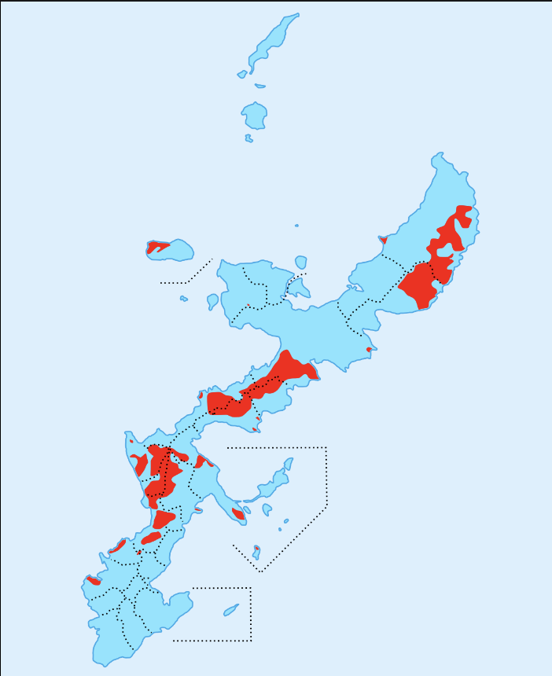
Qn 36.
ASIASWEEP 2023

Slide 66
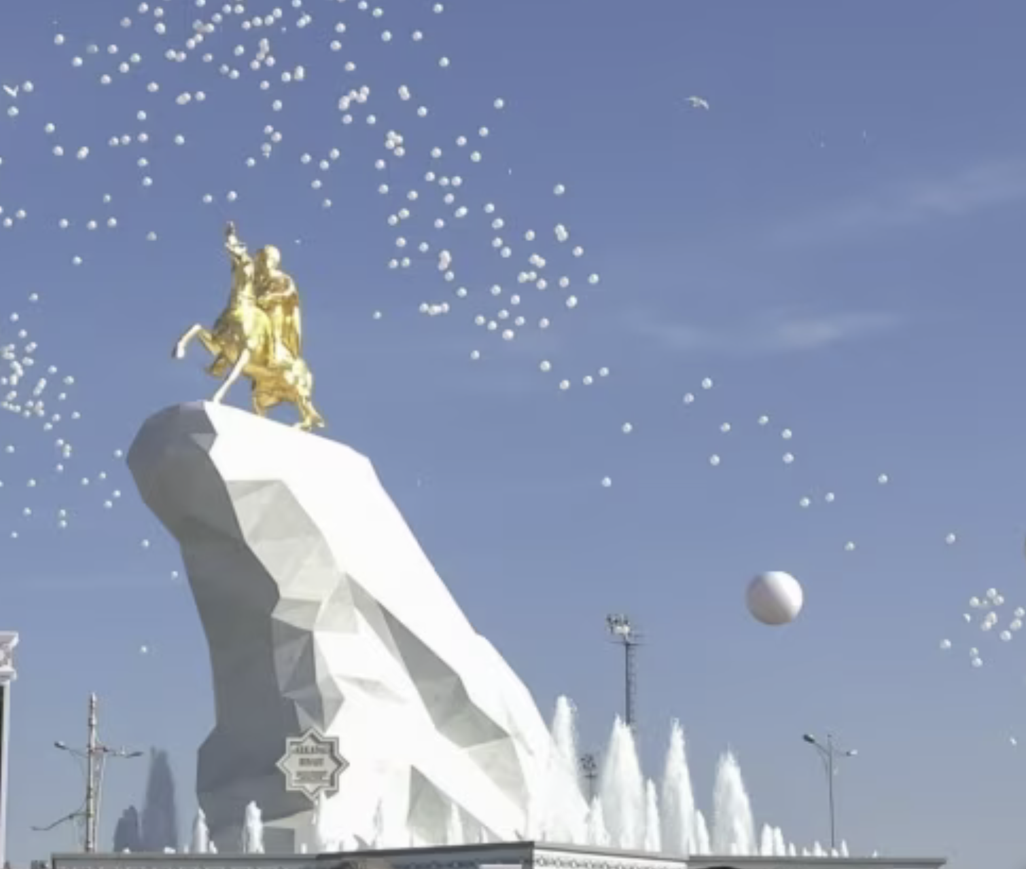
Qn 37.
In this horse-obsessed country A, their most famous proverb goes “Water is an A’s life, a horse is his wings, and a carpet is his soul.” The last Sunday in April is celebrated as National Horse Day.
In 2018, their president commissioned this monument to the B. With its thrusting marble pedestal, the monument bears a strong resemblance to C.
Give A, B and C.
ASIASWEEP 2023

Slide 67
Qn 37.
ASIASWEEP 2023

Slide 68
Qn 38.
In the country of its origins, tezhip meaning covering with gold almost died out as an art form because it became incomprehensible as the result of a government decision in 1915.
What does the art form involve? What decision? Which country?
ASIASWEEP 2023

Slide 69
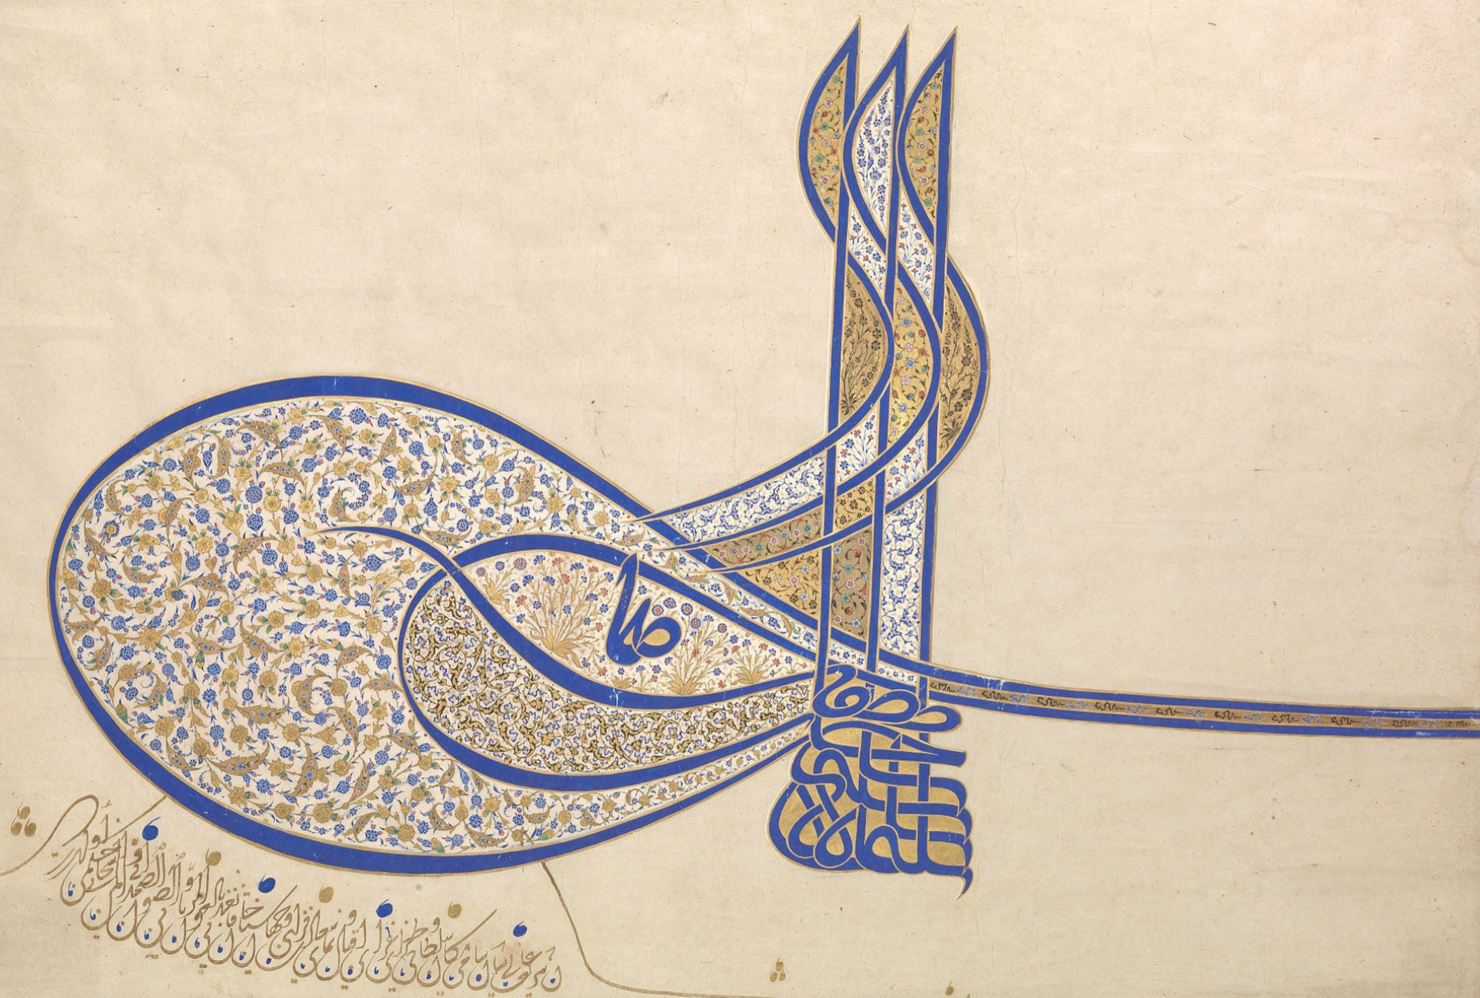
Qn 38.
ASIASWEEP 2023

Slide 70
Qn 39.
Um pais, dois sistema is the Portuguese equivalent of an idea broached in 1979 to A; it was rejected with a counter offer.
It was revived a decade later in anticipation of two events B and C, and continues to be in place, sort of.
Either name A or the idea, and give us B and C.
ASIASWEEP 2023

Slide 71
Qn 40.
A-B
In 1988, A was commissioned to write his country B’s Declaration of Independence, and began by calling it ‘the birthplace of the three monotheistic faiths’.
A had begun life as a writer for the national communist party Rakah and went on to become the most celebrated poet from that country. Name A and the country B.
ASIASWEEP 2023

Slide 72
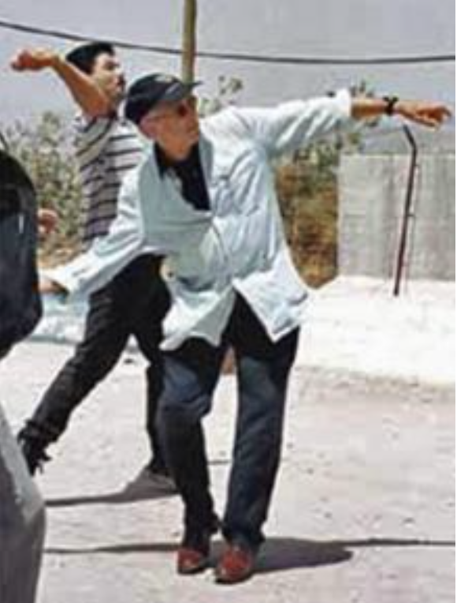
Qn 40.
C.
The person wearing a cap was famously described as a Professor of Terror years before this symbolic July 2000 act.
Identify this Conrad scholar, and creator of the West-Eastern Divan Orchestra who also translated A’s Declaration into English.
ASIASWEEP 2023

Slide 73
ASIASWEEP
SECTION IV
RULES
Azed
One question with five linked parts
Please follow the suggested order for parts ABCDE
ASIASWEEP 2023

Slide 74
Qn 41.
A.
This entity that flourished till 1796 is often called the world’s first MNC, and was administered by a set of seventeen lords drawn from four cities in Europe. Identify this entity A.
ASIASWEEP 2023

Slide 75
Qn 42.
B. They set up a planned capital city B, complete with canals, and named it after a region between the Rhine and the Meuse where an ancestral tribe had settled down.
What did they call this city?
ASIASWEEP 2023

Slide 76
Qn 43.
C; The entity’s profits came from the Maluku region. It kept trying to badger the Portuguese for control of commodities specific to two islands. One of the islands was C, well known for the best quality in a commodity locally called cendana.
Name either the commodity or the island for C.
ASIASWEEP 2023

Slide 77
Qn 44.
D. A were more successful in dislodging the Portuguese in the other island, Sri Lanka.
What prized commodity D fuelled this rivalry?
ASIASWEEP 2023

Slide 78
Qn 45.
E. A’s ascendance in our part of the world was centred around the control of a seaboard town on the east coast, near Madras. In 1741, they suffered a crushing defeat off another small town a little more to the south.
Name either their trading centre, or the Indian ruler who defeated them.
ASIASWEEP 2023

Slide 79
ASIASWEEP
SECTION V
RULES
05 questions
Take a guess on the theme connecting them
One bonus point for cracking theme
No negatives; enter guess at No. 51.
ASIASWEEP 2023

Slide 80
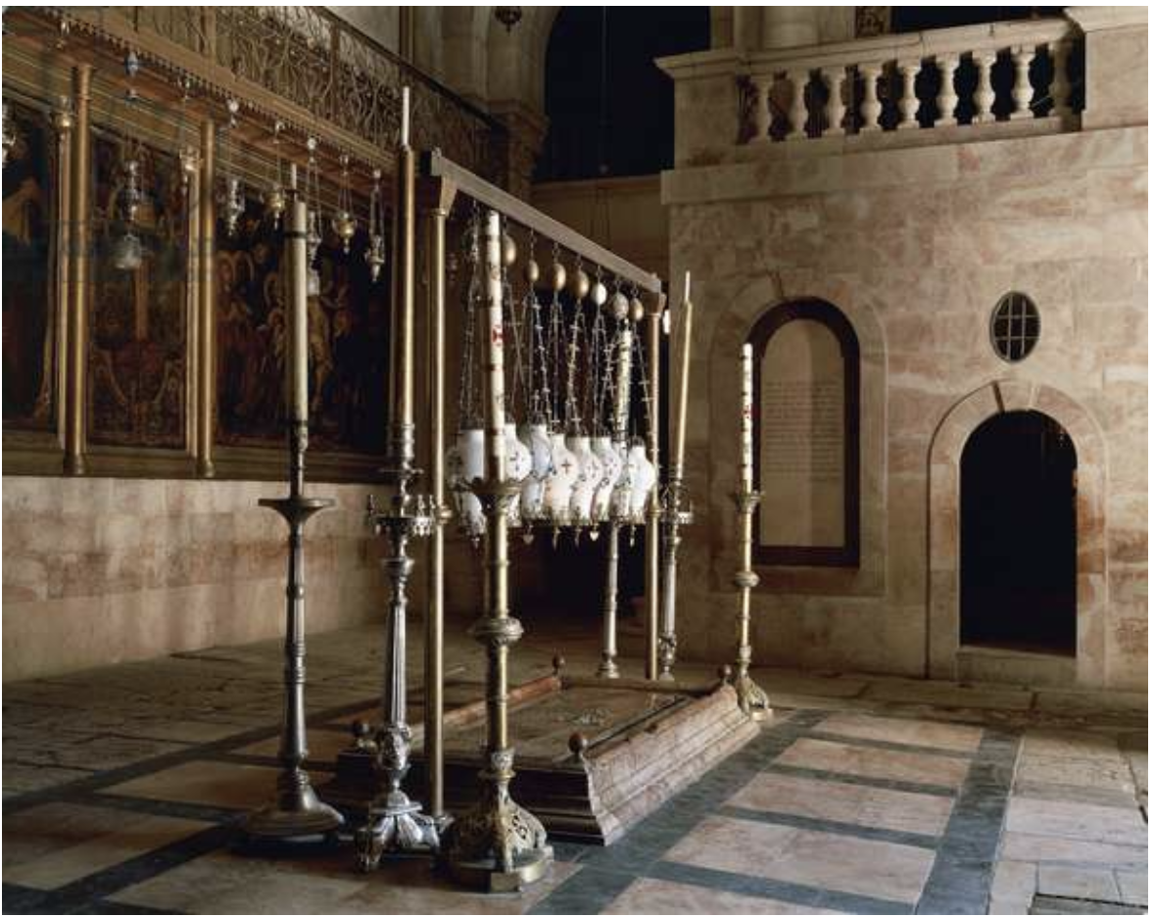
Qn 46.
Whose 1989 literary debut, while he was still in his 20s, begins at this site, the Qanisat al Kiyama, described as being “the size of a small broom cupboard”? He comes here to collect some oil which will allow him to replicate an errand.
ASIASWEEP 2023

Slide 81
Qn 46.
ASIASWEEP 2023

Slide 82
Qn 47.
Which durable character from the world of comics learnt his secrets at a mysterious college in Tibet before returning to life and celebrity in America?
ASIASWEEP 2023

Slide 83
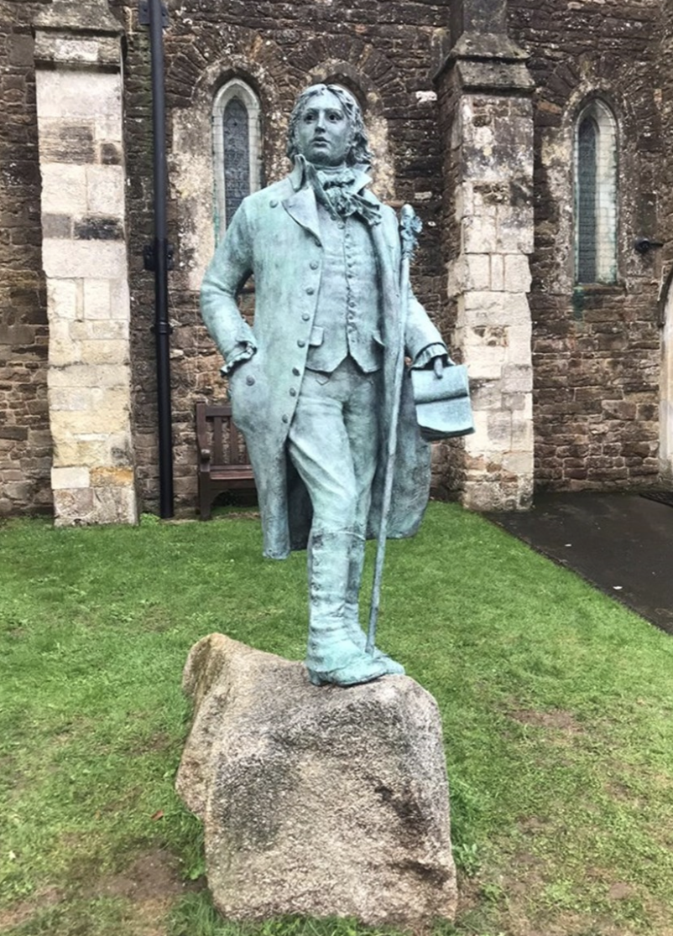
Qn 48.
The raising of this statue in the grounds of the church at Ottery St. Mary, Devon, was supported by Sir Andrew Motion and Hilary Mantel. She endorsed the drive with the words “He was a visionary who helped shape our national imagination, and it is right that he should have a memorial in the place that shaped him: and in the very churchyard where he told the secrets of his heart to the grass and the nettles.”
Identify this person who coined the phrase ‘suspension of disbelief’, and the word mountaineering after a short walking tour where he did not get high.
ASIASWEEP 2023

Slide 84
Qn 48.
ASIASWEEP 2023

Slide 85
Qn 49.
Suresh Sinha’s downfall combines with the making of a version of Devdas in which film?
Which Hollywood film is said to have been a direct influence on its storyline and cinematography?
ASIASWEEP 2023

Slide 86
Qn 50.
Robert Greenwald, who made the documentary Uncovered about the war in Iraq, made history in another way in 1980.
Something was created after a musical he directed starring Olivia Newton-John and Gene Kelly was turned into a double feature with the film Can’t Stop the Music, loosely inspired by the band Village People.
What was created thus in 1980? THEME GUESS ON 51.
ASIASWEEP 2023

